Slide 1
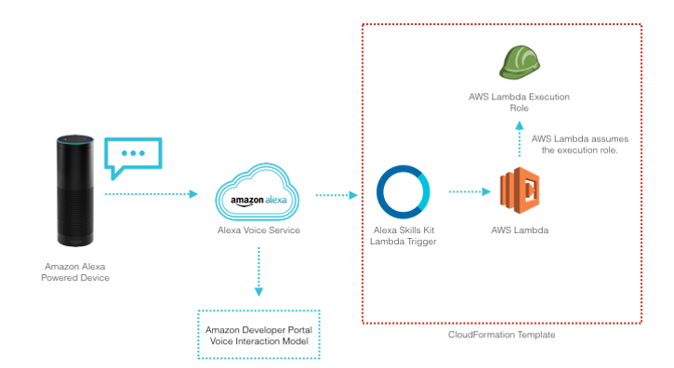

Slide 2

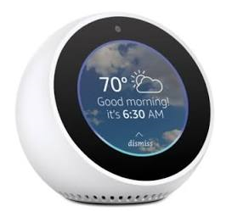

Alexa, My music
Play my combo
Alexa Voice
Service
Amazon Lambda
2
3
1
5a
6
Amazon
Echo
5b
Lambda
Function
4
Music Service
Playlist

Slide 3
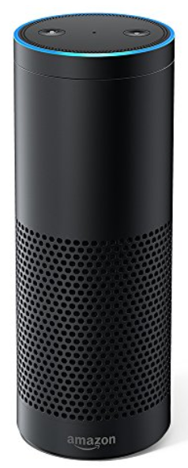
Alexa
Custom Skill
AWS Lambda
Cognitive Broker
Watson Developer Cloud

